Slide 1
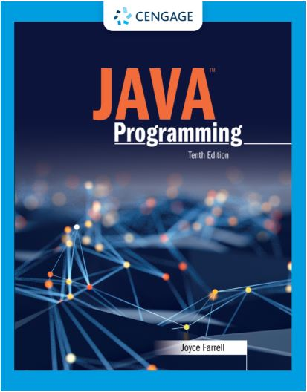
Java Programming, 10e
Chapter 01: Creating Java Programs
Joyce Farrell, Java Programming, 10th Edition. © 2023 Cengage. All Rights Reserved. May not be scanned, copied or duplicated, or posted to a publicly accessible website, in whole or in part.

Slide 2
Chapter Objectives
By the end of this chapter, you should be able to:
01.01 Define basic programming terminology
01.02 Compare procedural and object-oriented programming
01.03 Describe the features of the Java programming language
01.04 Analyze a Java application that produces console output
01.05 Compile a Java class and correct syntax errors
01.06 Run a Java application and correct logic errors
01.07 Add comments to a Java class
01.08 Create a Java application that produces GUI output
01.09 Identify and consult resources to help develop Java programming skills
Notes:
Instructions:
Briefly review with students the major concepts you will be covering during this class. There is one objective for every major A-Head section of the chapter.

Slide 3
1.1 Learning Programming Terminology (1 of 3)
Computer program
A set of written instructions that tells the computer what to do
Machine language
The most basic circuitry-level language
A low-level programming language
All programs get translated into machine language
High-level programming language
Allows you to use a vocabulary of reasonable terms

Slide 4
1.1 Learning Programming Terminology (2 of 3)
Syntax
A specific set of rules for the language
Program statements
Similar to English sentences
Commands to carry out program tasks
Compiler or interpreter
Translates language statements into machine code
Debugging
Freeing program of all errors

Slide 5
1.1 Learning Programming Terminology (3 of 3)
Syntax error
Misuse of language rules
A misspelled programming language word
Logic errors
Also called semantic errors
Incorrect order or procedure
The program may run but provide inaccurate output

Slide 6
Activity 1.1: Knowledge Check
Every language has its own specific, limited vocabulary called the language’s ________.
syntax
keywords
statements
commands
Notes:
Instructions:
Use the Knowledge Check questions to periodically pose a question to students during class to gauge how well they can recall the material that was presented.

Slide 7
Activity 1.1: Knowledge Check Answer
Every language has its own specific, limited vocabulary, called the language’s ________.
Answer: b. keywords
When you are learning a computer programming language, you are learning the vocabulary and syntax for the language.
Notes:
Instructions:
Use the Knowledge Check questions to periodically pose a question to students during class to gauge how well they can recall the material that was presented.

Slide 8
1.2 Comparing Procedural and Object-Oriented Programming Concepts (1 of 5)
Procedural programming
Sets of operations executed in sequence
Variables
Named computer memory locations that hold values
Procedures
Individual operations grouped into logical units
Object-oriented programs
Create classes
Blueprints for an object
Create objects from classes
Create applications
Notes:
Object-oriented programming was used most frequently for two major types of applications:
Computer simulations
Graphical user interfaces (GUIs)

Slide 9
1.2 Comparing Procedural and Object-Oriented Programming Concepts (2 of 5)
Class
Describes objects with common properties
A definition
An instance
Attributes
Characteristics that define an object
Differentiate objects of the same class
The value of attributes is an object’s state
Objects
Specific, concrete instances of a class

Slide 10
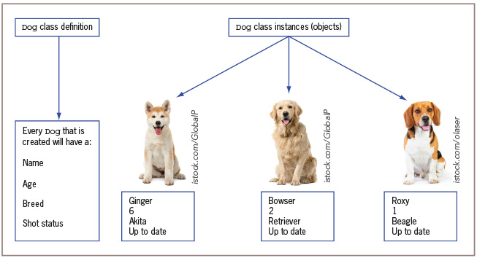
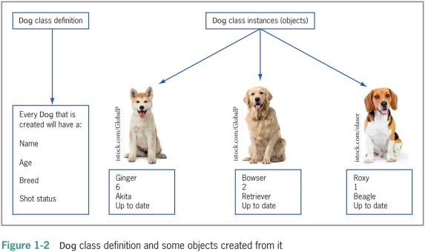
1.2 Comparing Procedural and Object-Oriented Programming Concepts (3 of 5)
Figure 1-2 Dog class definition and some objects created from it

Slide 11
1.2 Comparing Procedural and Object-Oriented Programming Concepts (4 of 5)
Method
A self-contained block of program code that carries out an action
Similar to a procedure
Encapsulation
Conceals internal values and methods from outside sources
Provides security
Keeps data and methods safe from inadvertent changes

Slide 12
1.2 Comparing Procedural and Object-Oriented Programming Concepts (5 of 5)
Inheritance
An important feature of object-oriented programs
Classes share attributes and methods of existing classes but with more specific features
Helps you understand real-world objects
Polymorphism
Means “many forms”
Allows the same word to be interpreted correctly in different situations based on context

Slide 13
1.3 Features of the Java Programming Language (1 of 4)
Java
Object-oriented general-purpose language
Can be run on a wide variety of computers
Does not execute instructions on the computer directly
Runs on a hypothetical computer known as a Java Virtual Machine (JVM)
Advantages:
Security features
Architecturally neutral

Slide 14
1.3 Features of the Java Programming Language (2 of 4)
Source code
Programming statements written in high-level programming language
Development environment
A set of tools used to write programs
Bytecode
Statements saved in a file
A binary program into which the Java compiler converts source code
Java interpreter
Checks bytecode and communicates with the operating system
Executes bytecode instructions line by line within the Java Virtual Machine

Slide 15
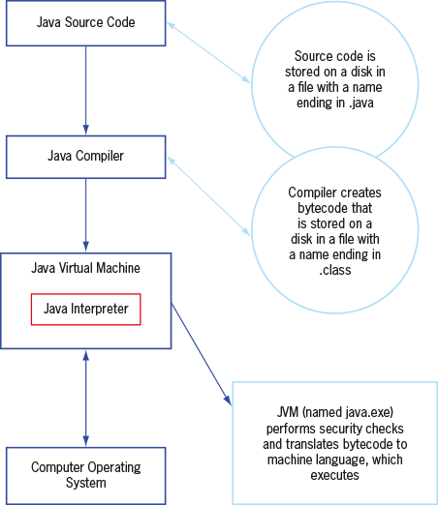
1.3 Features of the Java Programming Language (3 of 4)
Figure 1-3 The Java environment

Slide 16
1.3 Features of the Java Programming Language (4 of 4)
WORA
Write once, run anywhere
Console applications
Support character output
Windowed applications
Menus
Toolbars
Dialog boxes

Slide 17
Activity 1.2: Knowledge Check
The slogan, Write once, run anywhere, describes the ability of one Java program to ________.
work correctly on multiple platforms
translate into different languages
perform unrelated tasks
create GUIs
Notes:
Instructions:
Use the Knowledge Check questions to periodically pose a question to students during class to gauge how well they can recall the material that was presented.

Slide 18
Activity 1.2: Knowledge Check Answer
The slogan, Write once, run anywhere, describes the ability of one Java program to ________.
Answer: a. work correctly on multiple platforms
With Java, one program version can run on Windows, Macintosh, UNIX, and Linux.
Notes:
Instructions:
Use the Knowledge Check questions to periodically pose a question to students during class to gauge how well they can recall the material that was presented.

Slide 19
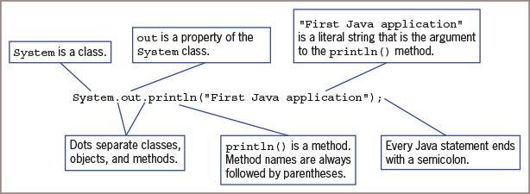
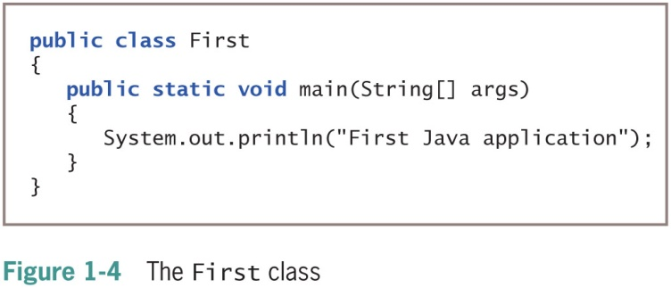
1.4 Analyzing a Java Application that Produces Console Output (1 of 9)
Figure 1-5 Anatomy of a Java statement

Slide 20
1.4 Analyzing a Java Application that Produces Console Output (2 of 9)
Even the simplest Java application involves a fair amount of confusing syntax.
All Java statements end with a semicolon.
Most Java statements can be spread across multiple lines if you place line breaks in appropriate places.

Slide 21
1.4 Analyzing a Java Application that Produces Console Output (3 of 9)
Literal string
Will appear in output exactly as entered
Written between double quotation marks
Arguments
Pieces of information passed to a method
Method
Requires information to perform its task
System class
Refers to the standard output device for a system

Slide 22
1.4 Analyzing a Java Application that Produces Console Output (4 of 9)
Everything used within a Java program must be part of a class
Define a Java class using any name or identifier
Upper Camel casing (Pascal casing)
Each word of an identifier begins with uppercase letter
UnderGradStudent
InventoryItem
Access specifier
Defines how a class can be accessed

Slide 23
1.4 Analyzing a Java Application that Produces Console Output (5 of 9)
Identifiers must begin with one of the following:
Letter of the English alphabet
Non-English letter (such as α or π)
Underscore
Dollar sign
Identifiers can only contain:
Letters
Digits
Underscores
Dollar signs

Slide 24
1.4 Analyzing a Java Application that Produces Console Output (6 of 9)
Identifiers cannot:
be a Java reserved keyword
be true, false, or null
begin with a digit

Slide 25
1.4 Analyzing a Java Application that Produces Console Output (7 of 9)
Method header
The first line in a method
Contains information about how other methods can interact with it
String class
Java class used to hold character strings

Slide 26
1.4 Analyzing a Java Application that Produces Console Output (8 of 9)
static
A reserved keyword
Means the method is accessible and usable even though no objects of the class exist
void
Use in the main() method header
Does not indicate the main() method is empty
Indicates the main() method does not return a value when called
Does not mean that main() doesn’t produce output

Slide 27
1.4 Analyzing a Java Application that Produces Console Output (9 of 9)
Indent Style
Use whitespace to organize code and improve readability
For every opening curly brace ( { ) in a Java program, there must be a corresponding closing curly brace
( } )
Placement of the opening and closing curly braces is not important to the compiler
Allman style used in text
To save a Java class
Save the class in a file with exactly the same name and .java extension
For public classes, class name and filename must match exactly

Slide 28
1.5 Compiling a Java Class and Correcting Syntax Errors (1 of 4)
Compiling a Java class
Compile the source code into bytecode
Translate the bytecode into executable statements using a Java interpreter
Type javac First.java
Compilation outcomes
javac is an unrecognized command
Program language error messages
No messages indicating successful completion

Slide 29
1.5 Compiling a Java Class and Correcting Syntax Errors (2 of 4)
Reasons for error messages
Misspelled the command javac
A misspelled filename
Not within the correct subfolder or subdirectory on the command line
Improper installation of Java

Slide 30
1.5 Compiling a Java Class and Correcting Syntax Errors (3 of 4)
The first line of the error message displays:
The name of the file where the error was found
The line number
The nature of the error
Next lines identify:
The symbol
The location

Slide 31
1.5 Compiling a Java Class and Correcting Syntax Errors (4 of 4)
Compile-time error
The compiler detects a violation of language rules
Refuses to translate the class to machine code
Parsing
Compiler divides source code into meaningful portions

Slide 32
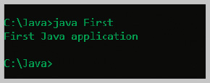
1.6 Running a Java Application and Correcting Logical Errors (1 of 4)
Run the application from the command line
Type java First
Shows the application’s output in the command window
The class is stored in a folder named Java on the C drive
Figure 1-18 Output of the First application

Slide 33
1.6 Running a Java Application and Correcting Logical Errors (2 of 4)
Modify the text file that contains the existing class
Save the file with changes using the same filename
Compile the class with the javac command
Interpret the class bytecode and execute the class using the java command

Slide 34
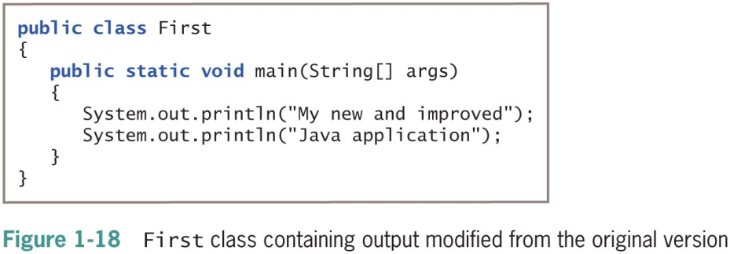
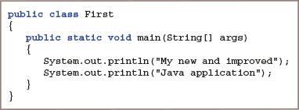
1.6 Running a Java Application and Correcting Logical Errors (3 of 4)
Figure 1-19 First class containing output modified from the original version

Slide 35
1.6 Running a Java Application and Correcting Logical Errors (4 of 4)
Logic error
The syntax is correct but incorrect results were produced when executed
Run-time error
Not detected until execution
Often difficult to find and resolve

Slide 36
1.7 Adding Comments to a Java Class (1 of 3)
Program comments
Nonexecuting statements added to a program for documentation
Use to leave notes for yourself or others
Include the author, date, and class’s name or function
Comment out a statement
Turn it into a comment
The compiler does not translate, and the JVM does not execute its command

Slide 37
1.7 Adding Comments to a Java Class (2 of 3)
Line comments
Start with two forward slashes (//)
Continue to the end of the current line
Do not require an ending symbol
Block comments
Start with a forward slash and an asterisk (/*)
End with an asterisk and a forward slash (*/)
Javadoc comments
A special case of block comments
Begin with a slash and two asterisks (/**)
End with an asterisk and a forward slash (*/)
Use to generate documentation

Slide 38
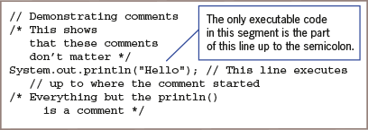
1.7 Adding Comments to a Java Class (3 of 3)
Figure 1-22 A program segment containing several comments

Slide 39
1.8 Creating a Java Application that Produces GUI Output (1 of 3)
Dialog box
A GUI object resembling a window
Messages placed for display
JOptionPane class is used to produce
import statement
Use to access a built-in Java class
Package
A group of classes

Slide 40
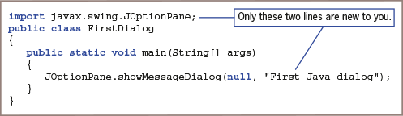
1.8 Creating a Java Application that Produces GUI Output (2 of 3)
Figure 1-23 The FirstDialog class

Slide 41
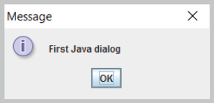
1.8 Creating a Java Application that Produces GUI Output (3 of 3)
Figure 1-24 Output of the FirstDialog application

Slide 42
1.9 Finding Help (1 of 3)
Java API
Also called the Java class library
Provides prewritten information about Java classes
FAQs on the Java Web site
Java Development Kit (JDK)
A software development kit (SDK) of programming tools
Free to download

Slide 43
1.9 Finding Help (2 of 3)
Don’t forget
The file’s name must match the class name
To end a block comment
Java is case sensitive
To end every statement with a semicolon
To recompile when making changes

Slide 44
1.9 Finding Help (3 of 3)
Don’t confuse these terms: Parentheses, braces, brackets, curly braces, square brackets, and angle brackets
Do not end class or method headers with a semicolon
Don’t panic when you see a lot of compiler error messages
Don’t assume your program is perfect when all compiler errors are eliminated

